Slide 1
Group 34
Migration Sentiment Victoria

Slide 2



Team Members & Motivation
Juan Daniel Daza – 846887
Junwen Zhang – 791773
Mingyan Wei – 280744
Wen Zhang -769355
Sai Sree Vatsav – 905157

Slide 3
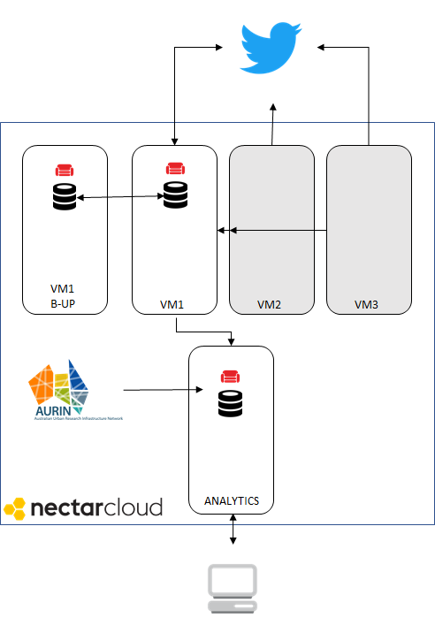
General Architecture
Intially had 3 VMs Harvesting Data
One separate Instance for backup (More resilient)
One Instance (Larger) for Analytics/Web
RESTful Flask & HTML front end with highcharts

Slide 4
Aurin Data
“Suburb Working Age Employment and Income”, created by Grattan Institute for the productive cities report and published in 2013
Median Income per Suburb
Employment Data per Suburb
Education Level per Suburb

Slide 5
Assumptions Used
Used Suburbs with more than 20 Tweets
Used Suburbs with all three categories (Positive, Neutral, Negative)
Compared Textblob vs AFINN - Chose Textblob (Outperformed AFINN)
Over 600K Tweets collected out of which over 50K had geo tagging.

Slide 6
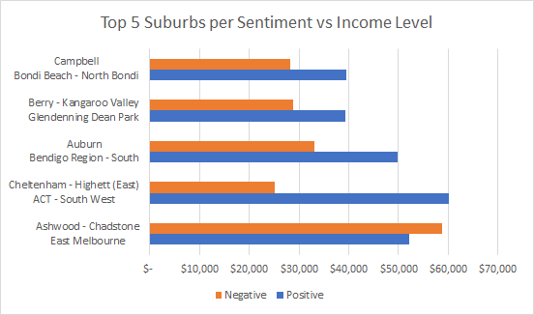
Twitter Scenario 3
Findings:
There is a correlation level between Income and Sentiment towards Migration

Slide 7
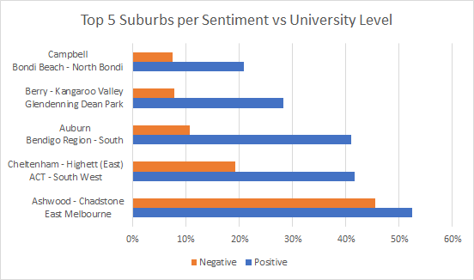
Twitter Scenario 3
Findings:
Clear correlation between level of Education and Sentiment towards Migration

Slide 8
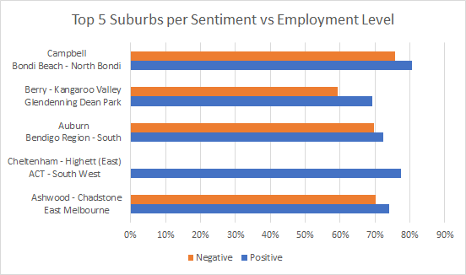
Twitter Scenario 3
Findings:
Cannnot really conclude a correlation between Employment level and sentimet towards migration
There is a slight positive correlation

Slide 9
Working Demonstration

Slide 10
Thank you

